Slide 1
Theatre Management System
BTech 4th CSE-B1
Atif Ayan - IU2241230127
Devjani Jigar Sunil Kumar – IU2241230164
Subject – Minor Project of Java
Date of Submission – 15/04/2024

Slide 2
List of Contents
Title Slide – 1
List of Contents - 2
Introduction – 3
Explanation using Images – 4, 5
Features of Java Used – 6, 7, 8
Flowchart for login – 9
Flowchart for Main function’s switch case – 10, 11
Flowchart for beverages menu - 12
Flowchart for payment gateway switch case – 13
Objectives – 14, 15, 16
Uses – 17, 18, 19
Applications – 20, 21, 22, 23

Slide 3
Introduction
A Theatre Management System (TMS) is a software or basically a technical solution designed to effectively automate the operations of a theater or a cinema.
It serves as the backbone of theater administration, facilitating various tasks ranging from ticket sales and seat reservations to scheduling screenings and managing concessions.
Basically It bring us from this to that :-

Slide 4
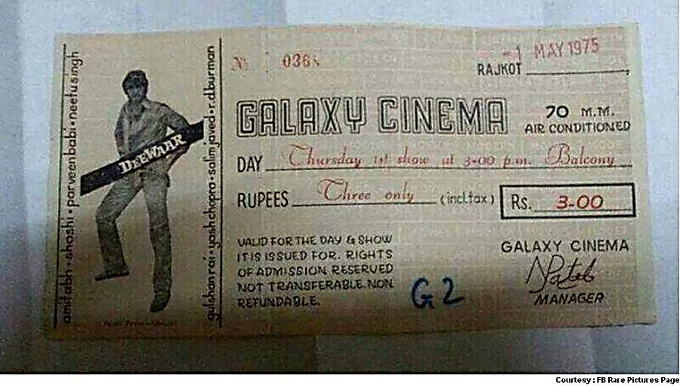
DEEWAR MOVIE TICKET

Slide 5
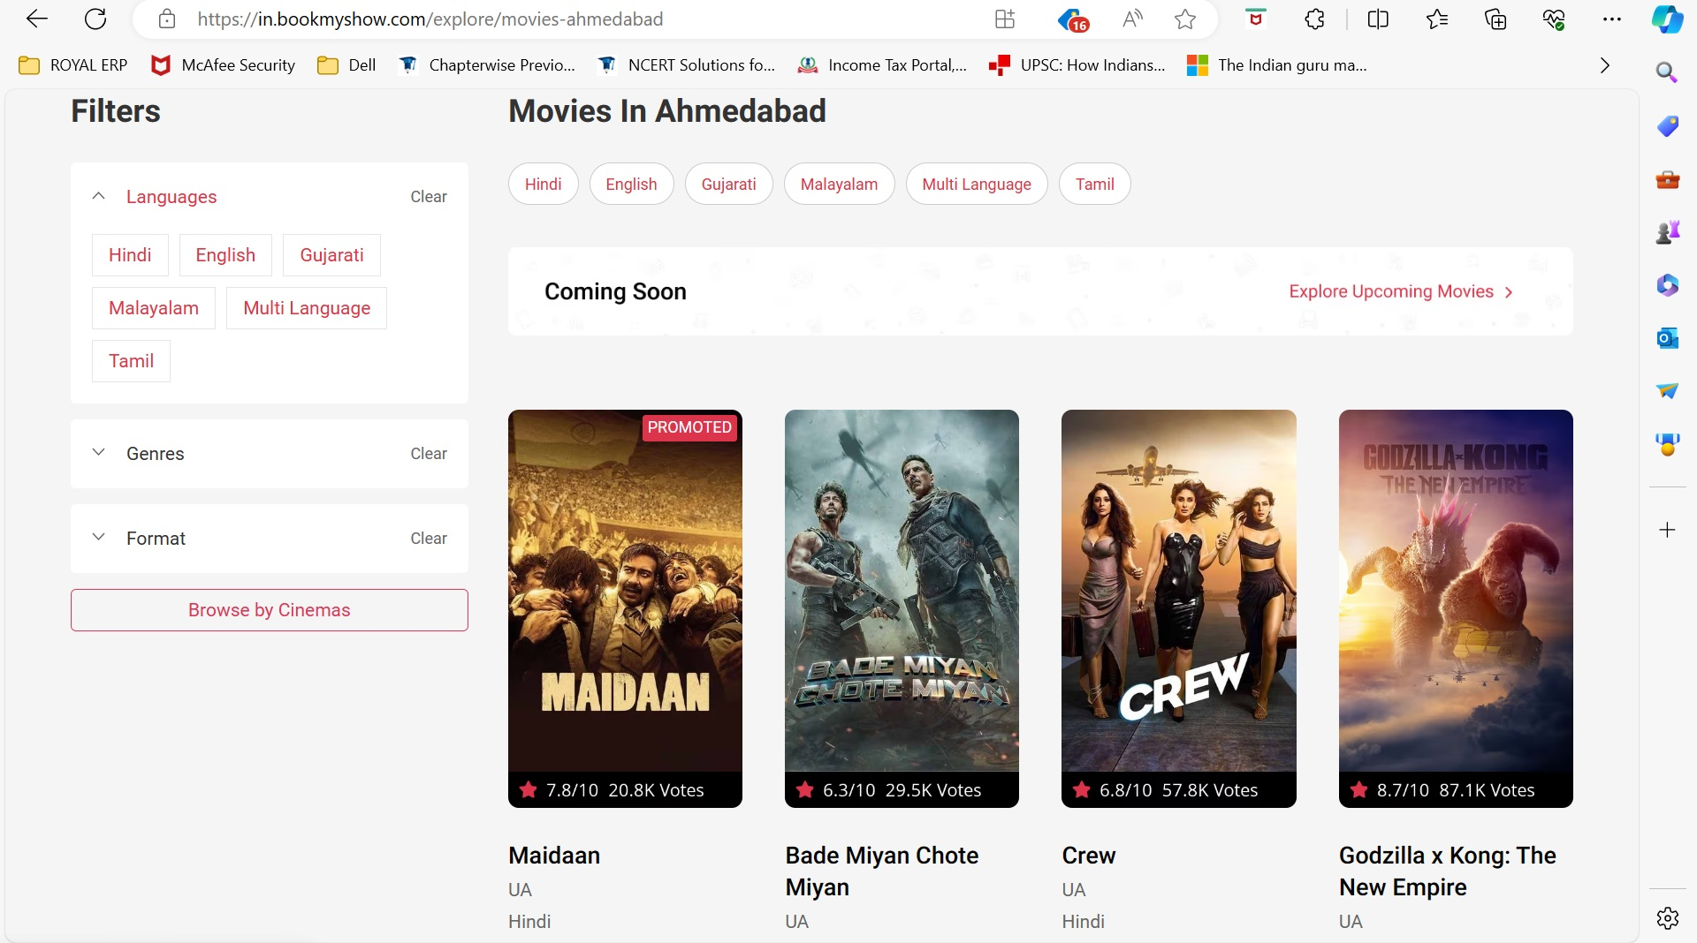
BOOKMYSHOW WEBSITE

Slide 6
Features of Java Used
This Java program for a Theatre Management System (TMS) utilizes several features of the Java programming language extensively. Here are some key points:
Classes and Objects : The program utilizes classes and objects extensively to model entities such as users, media, movies, and the theatre management system itself.
Inheritance : It demonstrates inheritance through the `Movie` class, which inherits from the `Media` class. This allows for code reuse and the organization of related attributes and methods.
Encapsulation : Encapsulation is achieved by making instance variables private and providing public methods to access and modify them. For example, in the `UserAuthentication` class, the `authenticate` method encapsulates the logic for user authentication.

Slide 7
Features of Java Used
Static Members and Static Initialization Block : Static members and static initialization blocks are used to initialize user credentials (`userCredentials` map) and other static data structures (`beverageMenu`). This ensures that the data is initialized only once when the class is loaded.
Polymorphism : Polymorphism is demonstrated through method overriding in the `Movie` class, where the `displayDetails` method is overridden to provide specific implementation details for movies.
User Input Handling : The program utilizes the `Scanner` class for handling user input from the console, allowing users to interact with the system by entering data and making choices.
Control Structures : Control structures such as `if-else`, `switch-case`, and loops (`while`, `for`) are used to implement program logic, control flow, and iterate over collections.

Slide 8
Features of Java Used
Exception Handling : Although not explicitly shown in the provided code, exception handling mechanisms like `try-catch` could be added to handle potential runtime errors or exceptions that may occur during program execution.
Comments : The code includes comments to document the purpose of classes, methods, and blocks of code, as well as to provide instructions for users and developers.
Method Overloading : Although not demonstrated in the provided code, method overloading could be used to define multiple versions of methods with the same name but different parameter lists, enhancing code readability and flexibility.
Overall, the program effectively utilizes various features of Java to implement a functional and interactive Theatre Management System.

Slide 9
FLOWCHART FOR LOGIN : -
Start
After declaration of username password. Take user input of them
Yes
details match
No
Display main menu loop located in main function
Display invalid input and recursively continues.
Terminate
Recursion

Slide 10
FLOWCHART FOR MAIN FUNCTION’S SWITCH CASE
Start
Declare choice variable and do apply switch case
Take user input
Apply that
Terminate

Slide 11
FLOWCHART FOR MAIN FUNCTION’S SWITCH CASE
Start
Input choice
If choice ==
1
2
3
4
Add Movie
Display Movie
Book Ticket
Exit
Exit

Slide 12
FLOWCHART FOR BEVERAGES MENU
Start
Input Beverages Available
Beverages Available =
Display Initialize Beverage Menu
Do no I/O operations
Terminate

Slide 13
FLOWCHART FOR PAYMENT GATEWAY SWITCH CASE
Start
Input payment choice (1-3)
payment choice ==
Cash
Credit Card
UPI
Process Cash choice
Process UPI choice
Process Credit Card choice
Terminate

Slide 14
Objectives
Efficient Ticket Booking : Enable customers to book tickets for movies or events easily and efficiently, reducing waiting times and manual processes.
Streamlined Operations : Automate various tasks involved in managing a theatre, such as scheduling movie showtimes, managing seat availability, handling payments, and tracking inventory.
Enhanced Customer Experience : Provide a seamless and enjoyable experience for customers by offering convenient ticket booking options, comfortable seating arrangements, and optional amenities like beverages and snacks.

Slide 15
Objectives
Improved Revenue Management : Optimize revenue generation through dynamic pricing strategies, targeted promotions, and efficient resource allocation.
Comprehensive Reporting and Analytics : Generate reports and analyse data related to ticket sales, customer preferences, movie performance, and financial metrics to make informed business decisions and identify areas for improvement.
Inventory Management : Manage and track inventory items such as tickets, food and beverages, merchandise, and other resources to ensure availability and prevent stockouts.

Slide 16
Objectives
Security and Access Control : Implement security measures to safeguard sensitive information, prevent unauthorized access to restricted areas, and ensure the safety of customers and staff.
Integration with Other Systems : Integrate with external systems such as payment gateways, CRM (Customer Relationship Management) software, and accounting systems to streamline operations and data exchange.
Flexibility and Scalability : Design the system to be flexible and scalable, allowing for easy adaptation to changing business requirements and accommodating growth in the number of customers, movies, and theatres.
Compliance and Regulation : Ensure compliance with industry regulations, data protection laws, and safety standards to maintain the reputation of the theatre and protect the interests of customers and stakeholders.

Slide 17
Uses
Efficient Ticket Management : The system allows for easy and efficient ticket booking, reservation, and cancellation, streamlining the entire ticketing process for customers and theatre administrators.
Enhanced Customer Experience : Customers can enjoy a seamless and hassle-free booking experience, with options to choose preferred seats, view show timings, and select additional services like beverages and snacks.
Optimized Resource Allocation : Theatre managers can optimize resource allocation by tracking seat availability, managing multiple screens, scheduling movie showtimes, and effectively utilizing theatre facilities

Slide 18
Uses
Improved Revenue Generation : The system supports dynamic pricing strategies, promotional offers, and loyalty programs to maximize ticket sales and concession revenue, contributing to the theatre's profitability.
Comprehensive Reporting and Analysis : Administrators can generate detailed reports and analyse key performance metrics such as ticket sales, attendance, revenue, and customer preferences to make data-driven decisions and plan future strategies.
Inventory and Asset Management : The system helps in managing inventory items such as tickets, food and beverages, merchandise, and equipment, ensuring adequate stock levels and preventing wastage or stockouts.
Automation of Administrative Tasks : Various administrative tasks, including employee management, payroll processing, accounting, and compliance reporting, can be automated, reducing manual effort and minimizing errors.

Slide 19
Uses
Integration with External Systems : The system can integrate with external systems such as payment gateways, CRM (Customer Relationship Management) software, and accounting platforms to streamline operations and ensure data consistency.
Customer Relationship Management (CRM) : By maintaining customer profiles, preferences, and purchase history, the system enables personalized marketing campaigns, targeted promotions, and effective customer engagement initiatives.
Scalability and Adaptability : The system is designed to be scalable and adaptable, allowing for easy expansion to accommodate new theatres, additional screens, and evolving business requirements over time.
Overall, the Theatre Management System project in Java serves as a comprehensive solution to manage all aspects of theatre operations, enhancing efficiency, profitability, and customer satisfaction.

Slide 20
Applications
The Theatre Management System project implemented in Java finds applications in various domains within the entertainment industry and beyond. Some of its key applications include:
Movie Theatres : The primary application of the system is in traditional movie theatres, where it facilitates ticket booking, seat reservation, concession sales, show scheduling, and overall management of theatre operations.
Multiplexes : Multi-screen cinema complexes benefit from the system's ability to manage multiple screens, diverse movie schedules, and concurrent events, ensuring efficient use of space and resources.

Slide 21
Applications
Event Venues : Beyond movies, the system can be adapted for managing events such as live performances, concerts, theatrical plays, and sports screenings, providing a centralized platform for event planning, ticketing, and audience management.
Amusement Parks : Amusement parks with theatres or 4D cinemas can utilize the system to manage ticketing, show timings, special events, and attractions, enhancing the visitor experience and optimizing park operations.
Cultural Centers and Auditoriums : Cultural centers, auditoriums, and performing arts venues can leverage the system for organizing theatrical productions, musical performances, lectures, and exhibitions, ensuring smooth ticketing and audience engagement.

Slide 22
Applications
Corporate Events : Large companies organizing employee events, seminars, conferences, or product launches can use the system to manage registrations, seat allocations, guest lists, and event logistics, improving event planning and execution.
Educational Institutions : Universities, colleges, and schools with auditoriums or screening facilities can adopt the system for managing student events, film screenings, academic lectures, and cultural programs, facilitating seamless event coordination and audience management.
Tourist Attractions : Tourist destinations with movie attractions, immersive experiences, or guided tours can implement the system to handle ticket sales, group bookings, multimedia presentations, and visitor engagement activities.

Slide 23
Applications
Community Centers and Clubs : Community centers, social clubs, and recreational facilities can deploy the system to organize movie nights, themed events, fundraisers, and social gatherings, providing members with convenient access to entertainment options.
Online Streaming Platforms : While primarily designed for physical venues, aspects of the system's functionality, such as user authentication, ticket booking, and content management, can be adapted for online streaming platforms offering virtual movie screenings and live events.
Overall, the Theatre Management System project in Java offers versatile applications across a wide range of entertainment and hospitality settings, enabling efficient management of events, venues, and customer interactions.

